Slide 1
Quantum Computing
A presentation by Daniel Easteal
Notes:
Hello there, my name is Daniel Easteal, thank you for giving me the opportunity to talk here, and welcome to my presentation about quantum computing

Slide 2
Outline
What is quantum computing?
Why I am passionate about it?
How it impacts people.
Security is important!
Notes:
In this presentation I will be gong through what quantum computing is, why I am passionate about it, how this technology impacts people and why security is important

Slide 3
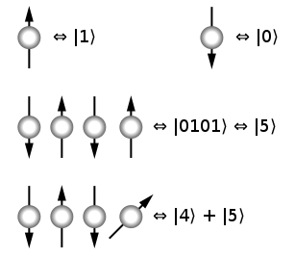
Quantum computing…what is it?
Notes:
Classical bits
Qubits
Diagram
Probability
Lowest point in a vast landscape
Made by D-Wave
Computing with qubits rather than bits
Uses superposition of particles
Returns a probability for minimisation
Produced by D-Wave
Ok, so to start off with I will quickly explain how quantum computers actually work and therefore what they are good for. To start off with you need to know that quantum computers don’t work with the standard bits 1,0 that computers use but instead they use something called a qubit, now this is where it gets strange and into the world of quantum mechanics comes into play hence the name. a qubit is a particle that is either in a spin up state ( shown here ) as one, or in a spin down state ( shown here ) as 0, now like this you can use them normally as shown here as the binary for 5 is 0101, but they can also be in a super position as shown here. In this state it is a 1 and a 0 at the same time. So this is 4 or 5. Due to this when you do computing you will get a probability as the answer. This then means that it is very good at solving stuff that is not well defined or is of a high level. This then leads to them being so powerful.
lowest point in a vast landscape

Slide 4
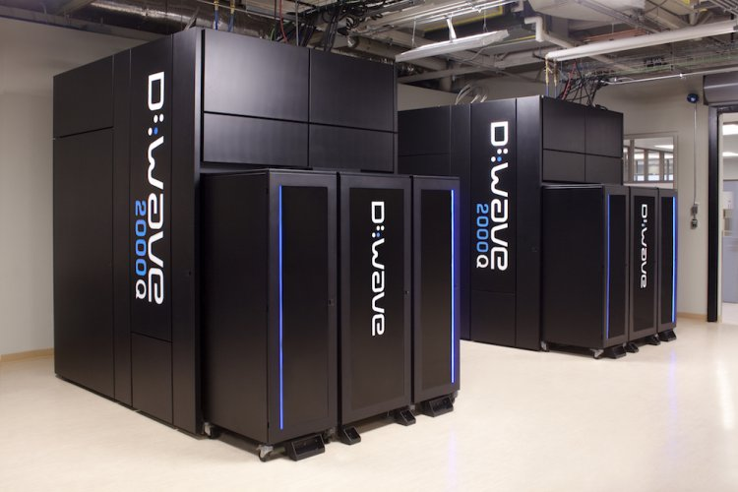
Why I am passionate about this…
Changes how computation can be done
Currently, huge undiscovered potential
Seems futuristic but it actually exists
Notes:
Be more personal, explain how you are interested
Maybe say about beginning of classical computers
Ok, so now that you have a small idea of what quantum computers are and how they work, there is the question of why I am passionate about them and why I think they could grow to be a main technology used in the world.
The main thing that I would say is that interests me and makes me passionate is the fact that quantum computers will change how computation can be done. By this I mean they will use the qubits that I just talked about and so they way that we would do calculations and use computers will change drastically in places that they are used. And for me that is just really interesting to think and research about how this would work.
This then leads on to the huge and currently undiscovered potential that they therefore have for the future. As this is a new technology there are loads of things about it that we don’t know or understand at all, in addition to this there are also so many applications of quantum computers that we don’t know are applicable. The unknown here is really something that draws me into this.
Finally, I am also passionate about this due to the fact that this seems to be so futuristic, buts its an actual things that is happening right now, and I think that there is not a better time to be interested in this.

Slide 5
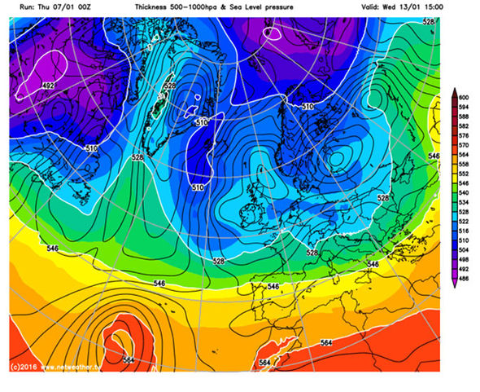
How it impacts society
Weather forecasting
Best accurate forecasting a week in advance
Far too much data to analyse at once
“We'd have advanced notice of major storms like hurricanes and the extra prep time could help save lives.” - Ray Johnson board member at QxBranch
Source http://uk.businessinsider.com/quantum-computers-will-change-the-world-2015-4
Notes:
Not just lives but also crops and so on
amazing
But how about in a more general sense rather than just an individual or a company, what about society in general. Well, a new technology that could help with that is self driving cars as they have the potential to save thousands of lives and make travel more efficient. Well, as you may know, google are currently the main people who are working on self driving cars and they are the main people with quantum computers so they decided to combine them.
The way that they did this was that they got the quantum computers to come up with ways of recognising what is actually in an image and then translating that to a way that the cars can use in real time, in addition to this the quantum computers also helped write the algorithms and the code for the cars. As you may know, this has been a good success and google have even said so as they have said it works great: Google has shown the D-Wave can significantly outperform on traditional chips”

Slide 6
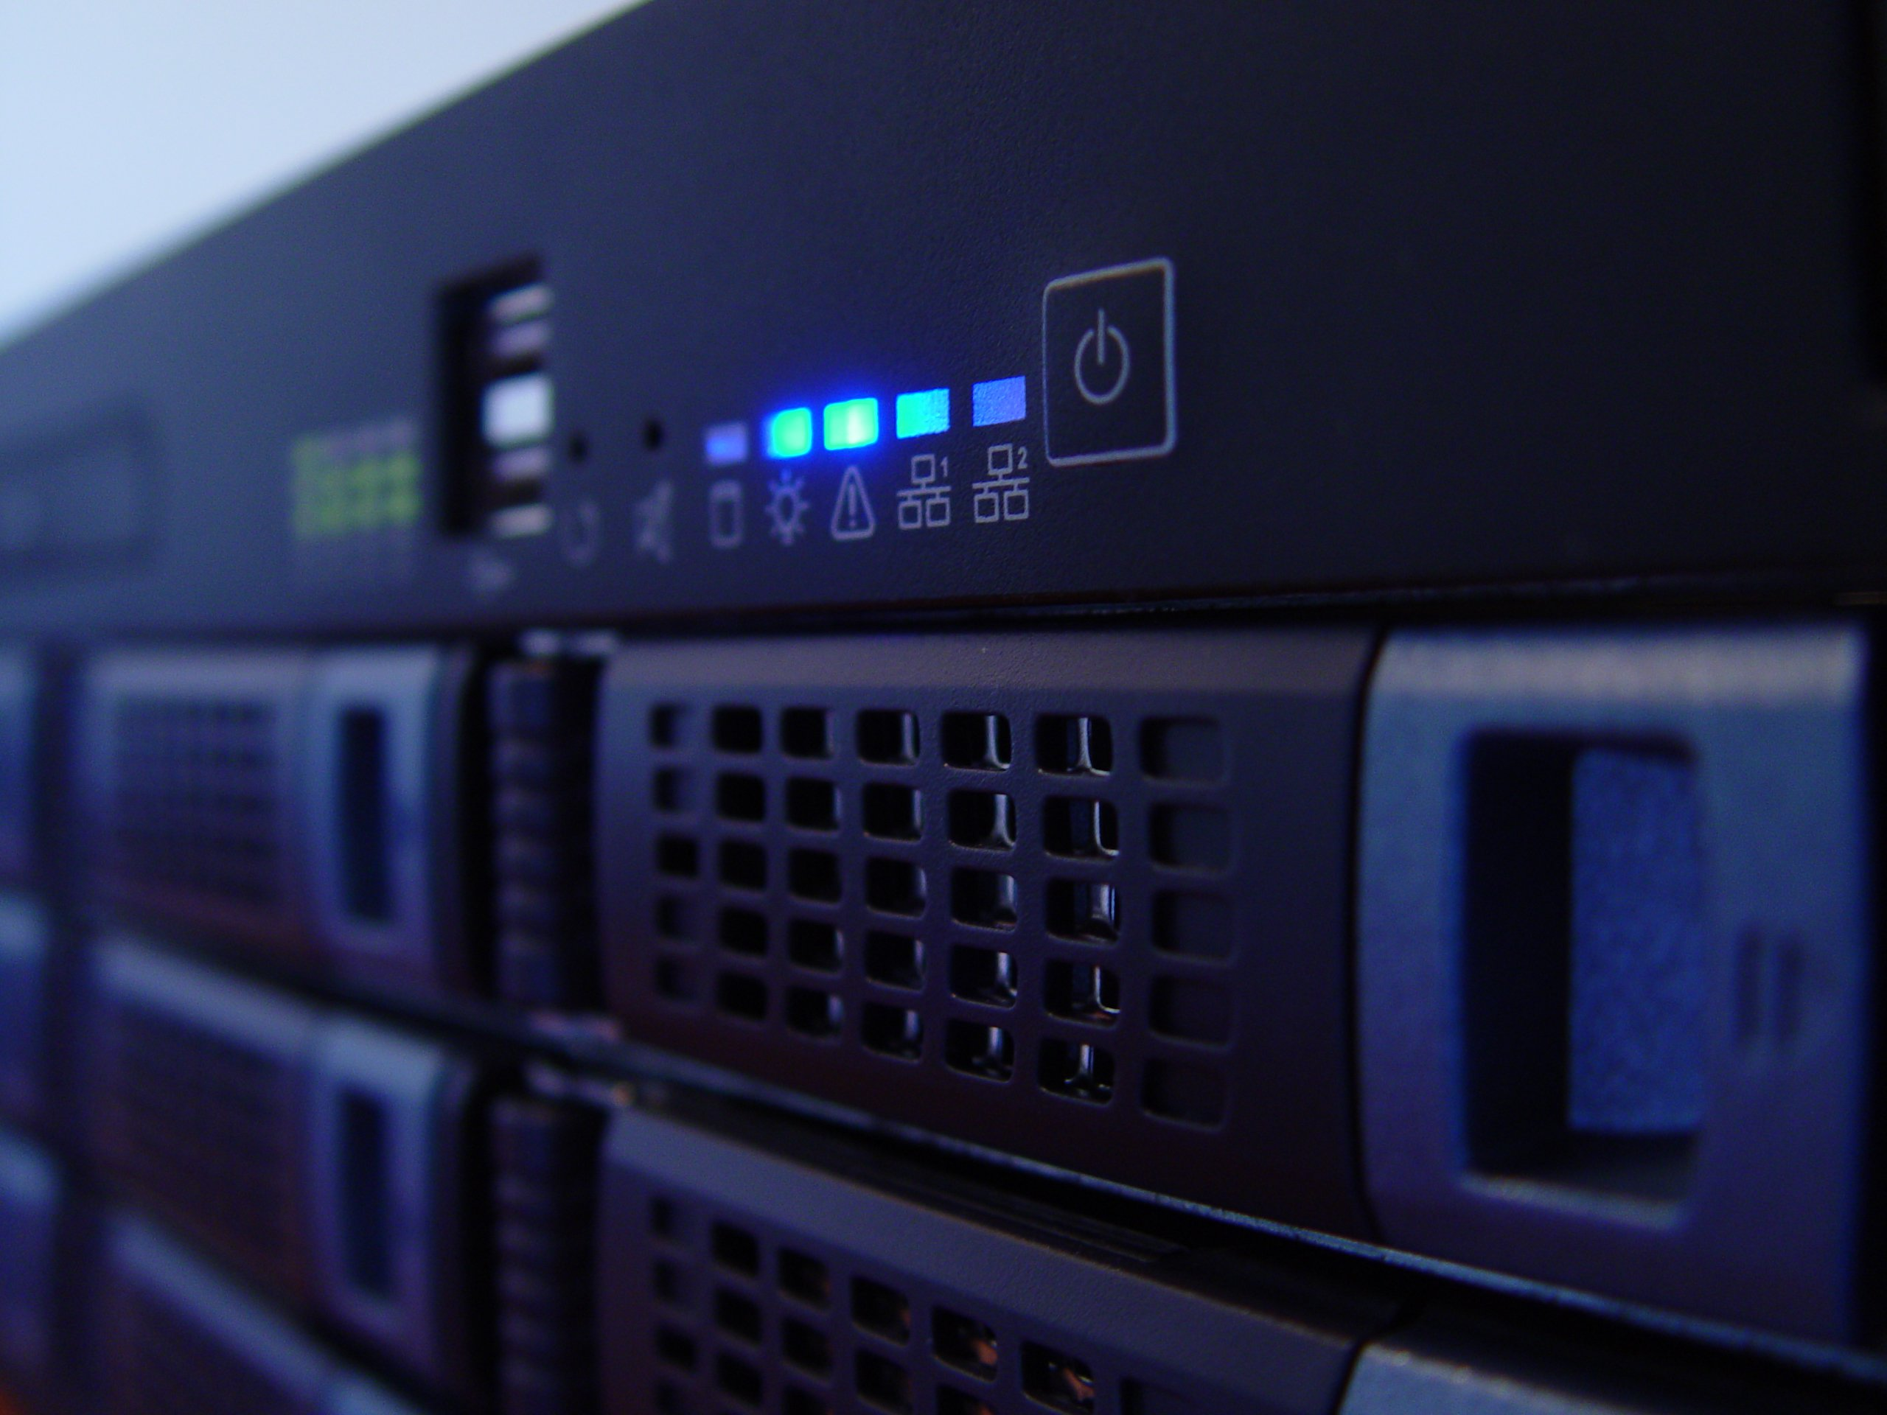
How it impacts businesses
Finance and trading
Used by Guggenheim Partners
Risk modelling and market instabilities are essential
“We can build an optimal portfolio today, but tomorrow it won't be optimal and needs to be rebalanced, which is expensive” - Marcos Lopez de Prado senior managing director at Guggenheim Partners
Source: http://www.bbc.co.uk/news/business-35886456
Notes:
But enough about me, what about other people like those who own and run business. And as you can think there is a lot that quantum computers can do for them as well with loads of jobs and here is just one example and this is in finance and trading;
So, there is this company called Guggenheim Partners and they are a financial company that offers services to do investment and advisement with money. Due to this they are always wanting a way to make their system better than any other business to find and predict the market so that they can model it and that’s where quantum computers come in. with their processing power working well with this type of computation Guggenheim Partners have partnered with Dwave so that they are now using quantum computers to help them with this. When asked about classical computers compared to quantum computers they said that with classical computers “We can build an optimal portfolio today, but tomorrow it won't be optimal and needs to be rebalanced, which is expensive” and this is where quantum computers can make a huge difference to this to save them money and get the latest and best for their customers.

Slide 7

How it impacts me
Career future
Working in the IT field
Quantum computing will have a massive impact
Notes:
More committed I WILL BE I expect in 20 years time that qc will be used all the time and be an integral part
So, you know that I find quantum computing interesting, but how does it actually impact me on a daily basis and work in the real world. Well, right here I have an example of what it can do and that is labelling news stories and images appropriately. At first this may sound a bit strange as computers at the moment can do this and it seems like it is of no consequence, but it is. Whenever you read a news article online it will have a certain topic to it, or if you are searching for images then all of them will be of something and these are things that need to be computed.
Now there are some corpuses of example of these things and they are the REUTERS corpus for news articles and the SCENE corpus for images. With these in mind the people at Dwave have trained the quantum computer to recognise what labelling should be and what to do, and to see the results we only need to look at what they have said: We found that our approach worked extremely well on these problems” , that’s amazing when you think about it as they have said that it has been a success, but it doesn’t just need to work…it needs to work well, and well lets see what they say about that: “[Dwave] provided better labeling accuracy than a state of the art conventional approach”, thus us great for quantum computers as they work and they work well meaning that this could become widespread in the future.

Slide 8
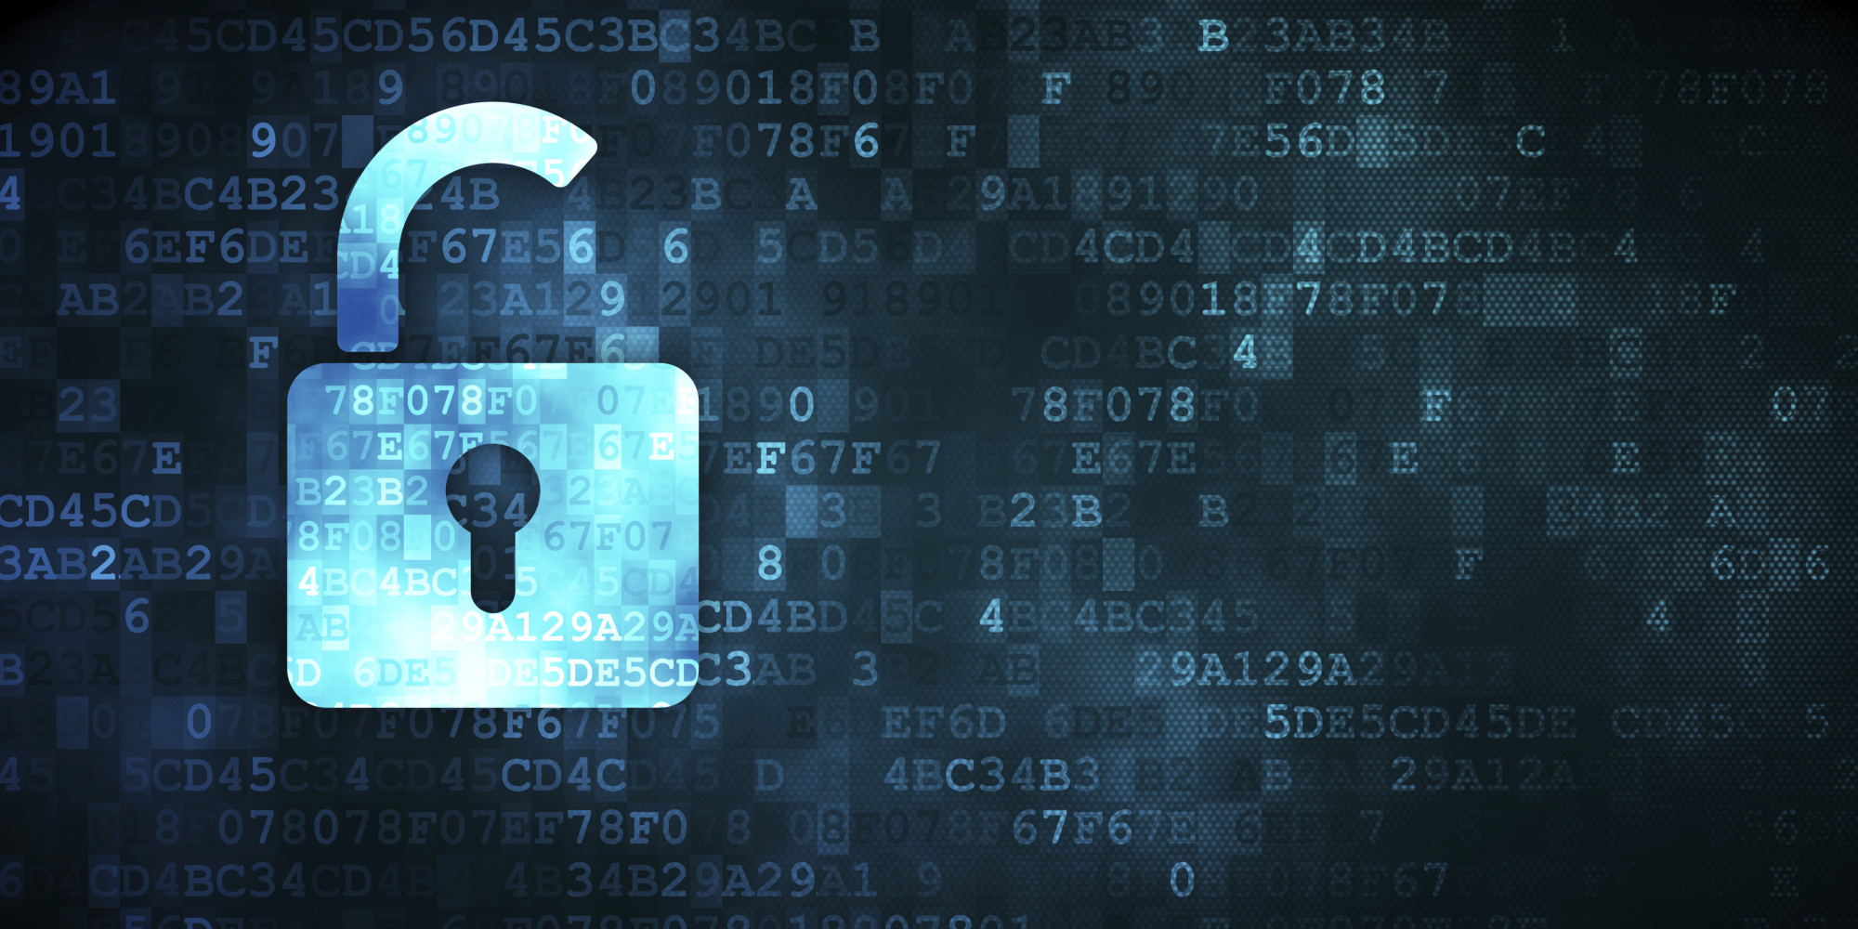
Security is important!
Quantum computers can easily solve encryption
Grover's algorithm
Quantum secure signatures
Can easily be used fraudulently
They need to be securely accessed
Source: https://blogs.cisco.com/security/quantum-resistant-signatures-an-update
https://en.wikipedia.org/wiki/Grover%27s_algorithm
http://www.wired.co.uk/article/quantum-computers-quantum-security-encryption
Notes:
More opportunistic, those using quantum can be much more secure than classical
Don’t say not how you think
50 and 10 are EXPECTED results
Finally, there is the more pressing and important matter that is at hand, and that is security with these machine in terms of how they could break it and how they need to be secure. As mentioned before quantum computers are really good at doing computation on masses of data that can be formed in a 3D minimisation and it just so happens that classical encryption that we are all used to can be placed in that form and solved incredibly easily with some algorithms. One of the most relevant ones would have to be Grover's algorithm, and this is used in brute forcing passwords. Normally, when you brute force something if there were 100 different passwords then you have to try them all, and on average you would get it after 50. Now I don’t understand how Grover's algorithm works, but I know what it produces, and basically it only needs to test the square root of the possibilities before it finds the answer so using quantum computing you will only need to try 10 passwords, rather than 50 and that’s worrying.
One other example of security would have to be the fact that these computers need to be secure and only accessed by people who are legitimate with them due to this power that I have just mentioned. At the moment, you can access a quantum computer to program on, but it is VERY difficult as you have to be verified by google as a developer for quantum computers and then partner your business with them and get all the legal that is to go with that, so it is and needs to be very secure so that’s good at the moment, but there is always some way to get in so there is need for concern. Cisco stuff could help the security and partner with them.

Slide 9
Quantum Computing
Daniel Easteal – dan0qn@hotmail.co.uk
Notes:
So hopefully you can see how quantum computing is really interesting and the huge impact that it could have in the future. Any questions?

